Slide 1
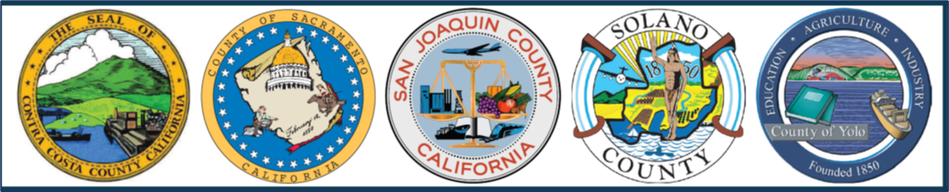

What is the Delta Tunnel?
Presentation by the Delta Counties Coalition
Ryan Hernandez
Contra Costa County
Kelley Taber
Somach Simmons & Dunn

Slide 2
Sacramento-San Joaquin Delta
Delta Tunnel Project Overview
  Bethany Alternative - Preferred
River Flows - Sacramento and San Joaquin
Presentation Outline

Slide 3
Sacramento- San Joaquin Delta
National Heritage Area
Notes:
Update with how and why the Delta is so important, facts:
The Delta lies at the junction of California’s two largest rivers - the Sacramento and San Joaquin. The Sacramento-San Joaquin Delta is California’s most crucial water and ecological resource. It is the largest freshwater tidal estuary of its kind on the west coast of the Americas, providing important habitat for birds on the Pacific Flyway and for fish that live in or pass through the Delta.
Historically, the bounty of vast wetlands here allowed population density of the indigenous people to become, what was thought to be, the second highest in North America before European contact.
California gold rush in the 1840’s brought all through the Delta.
Late 19th century saw the start of a massive reclamation that turned marshland into farmland, and the development of unique communities and cultural centers.
And the 20th century brough the development of the large scale federal and state infrastructure projects that send Delta water to irrigate agriculture up and down the Central valley and supply drinking water to cities from the Bay to Southern Cal.
And yet the Delta is a rural place, with fish, birds and at times is full of freshwater. It’s been described as an engineering marvel, but we must also recognize it’s an important ecosystem, largest on the West Coast, with historic towns, scenic roads, farm stands, and ample opportunities for recreation like boating, birding, biking and fishing. Its importance was recognized when it was designated a National Heritage Area in 2019. National Heritage Areas are designated by Congress as places where natural, cultural, historic, and recreation resources combine to form a cohesive, nationally important landscape.
The Delta is an evolving place, and we must protect, enhance, and sustain the unique cultural, historical, recreational, and agricultural values.

Slide 4
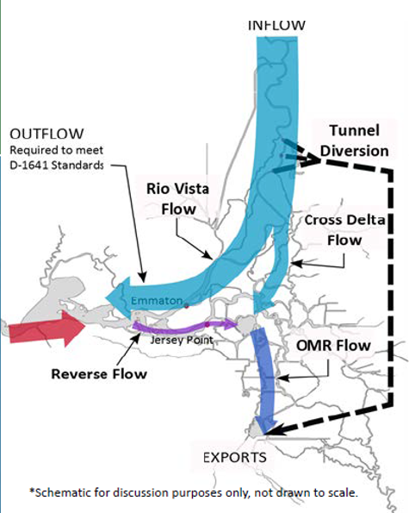
What is the Delta Tunnel?
The Delta tunnel project is the latest version of a massive State water infrastructure project to redirect Delta flows.
Previous names and programs associated with the concept include:
Peripheral Canal (1940-1982)
CALFED (1990-2000)
Bay Delta Conservation Plan (2008-2014)
California WaterFix (2015-2019)
Delta Conveyance Project (Current)
Notes:
What is the Delta Tunnel?
Massive infrastructure project that’s been proposed w/ various names since the State Water Project was built.
The Delta tunnel is known as an Isolated Conveyance.
And why is that important?
Because an isolated conveyance uses a tunnel to divert water around the Delta. The tunnel takes freshwater out of the Sacramento River and sends it directly to the export pumps and the freshwater flows do not go through the Delta.
This negatively impacts water quality in the Delta while improving water quality for south of Delta exports.

Slide 5
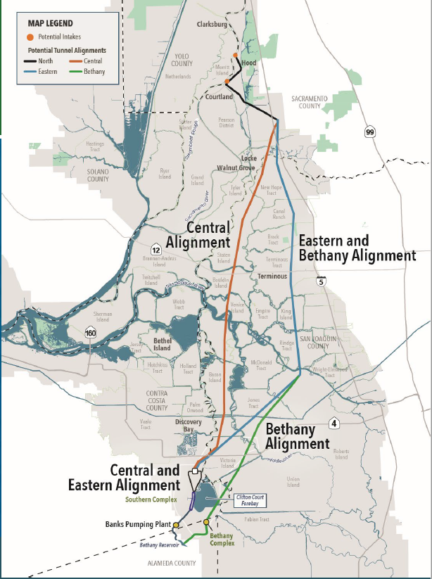
What is the Delta Tunnel?
Would divert water from Sacramento River near Hood and Courtland;
40-foot diameter concrete tunnel approx. 40 miles long;
Buried 150 feet below the surface;
Terminating near export pumps.
Delta Counties’ Water Summit
Notes:
Discuss the scale of the project:
Distance: The tunnel is just less than the drive from Sacramento to Stockton. Antioch to SF. 40 miles long;
Through a 40-foot diameter concrete tunnel. A full-sized school bus is approx. 40 feet long. And this is all occurring 150-feet below the surface of the Delta;
Terminating at the Bethany Reservoir near the export pumps.

Slide 6
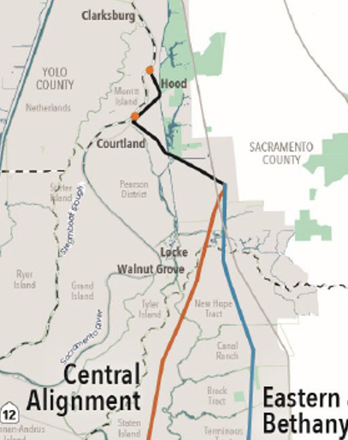
What is the Delta Tunnel?
Includes:
Two 3,000 cubic feet per second intakes at Hood and Courtland (each almost 1/4 mile long)
14 years of construction 24hrs/day, 7 days/week
Heavy truck trips on I-5 and local roads (200,000+ truck trips)
Notes:
Imagine 3000 basketballs per second filling TWO quarter mile long intakes.
The tunnel (aka “isolated conveyance”) would divert water from the Sacramento River near Hood and Courtland;
Through a 40-foot diameter concrete tunnel that is approx. 40 miles long;
Buried 150-feet below the surface of the Delta;
Terminating near the export pumps.
Highlight the Bethany Alternative as DWRs preferred route. – Yellow Arrows

Slide 7
What is the Delta Tunnel?
Does not include:
Any local benefits (e.g., water supplies)
Cost: $16 billion +
Notes:
DWR is touting a possible “community benefits program,” but so far it has offered nothing other than temporary construction jobs. The tunnel does nothing to protect Delta water users from sea level rise or seismic risk.
Estimated Cost is in 2020 dollars and does not account for inflation and other increased construction costs --- DWR estimates construction would not start before 2030, and would take well over a decade.

Slide 8
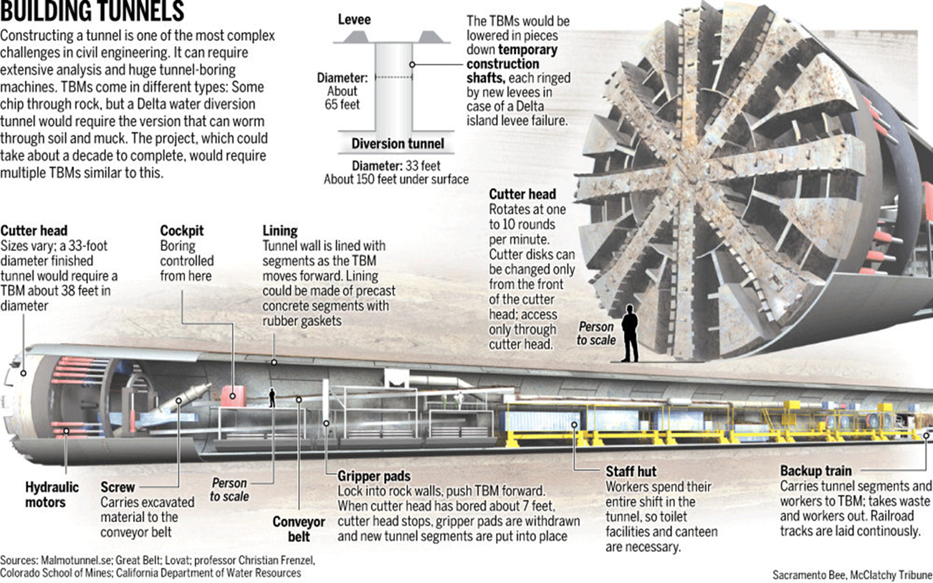
Tunnel Construction
Notes:
Discuss the scale of the project:
Simply highlight the person, to scale, standing next to the Tunnel Boring Machine.

Slide 9
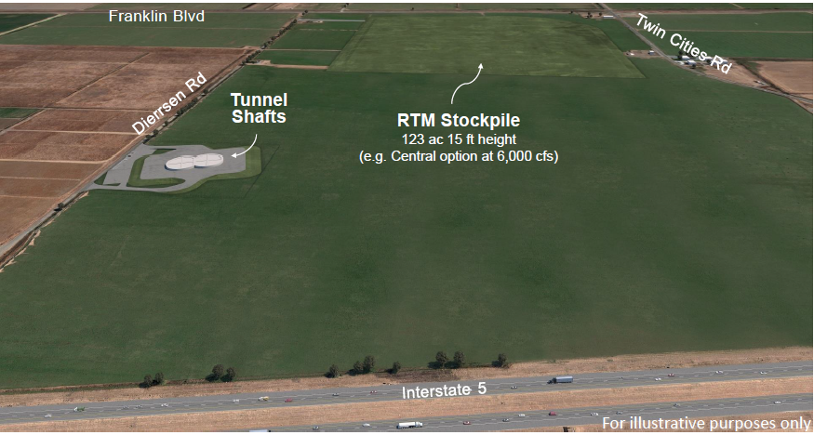
Tunnel Muck is Permanent
No plan to actually reuse so-called “Reusable Tunnel Material”
123 acres of muck piled 15 feet high
Twin Cities Road and I-5
Notes:
Discuss the scale of the project:
How big is 100 acres?
Despite the misnomer “reusable tunnel muck,” DWR has no plan to dispose or reuse tunnel spoils but rather will just be dumping it on Delta farmland in two story high piles that would cover hundreds of acres

Slide 10
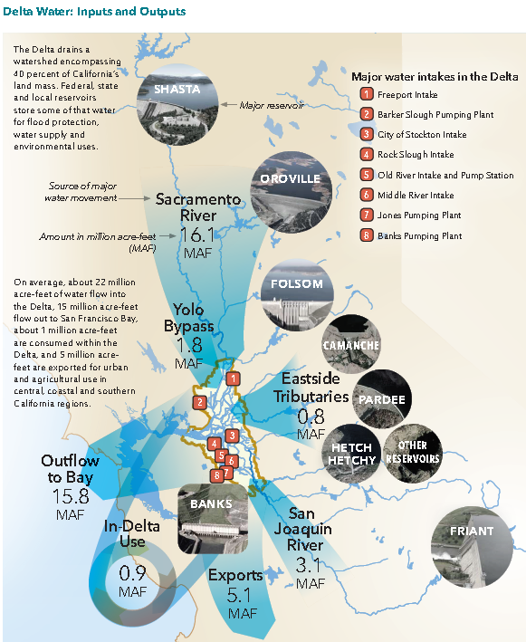
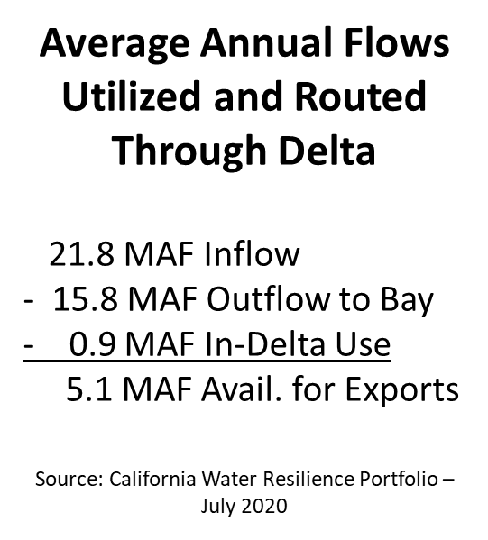

Flows and
Water Quality
Notes:
When you hear folks talk about California’s water system is an engineering marvel, this is what they mean.
The Delta drains a watershed that totals 40% of California’s water. Federal, State and local reservoirs store some of that water for flood protection, water supply and environmental uses.
Enough freshwater must flow through the Delta throughout dry months to repel saltwater that pushes inland from the ocean and SF Bay. And reservoirs are used, in part, to help control salinity from reaching the Delta.
During drought conditions there is not enough water in upstream reservoirs to push the salt water back, it can contaminate the channels that supply water to the CVP and SWP (aka south of Delta Exports)

Slide 11
Keep Water Flowing
Through the Delta
Tunnel is a threat
Takes fresh water, bypassing the ecosystem = less water through the Delta
Improves export water quality at expense of water quality for Delta residents, farming
A tunnel provides no incentive to help protect and improve water quality in the Delta
Notes:
The Delta provides a common resource, including freshwater supply for all Delta water users and all those whose actions have an impact on the Delta's health share in the obligation to restore, maintain and protect the Delta including water supplies, water quality, levees and the estuary.
Delta exports disproportionately impact the environment, fish and wildlife because the flows are so negligible that the estuary doesn’t work like an estuary anymore. (Harmful Algal Blooms, 6/20 CCC Notice for Discovery Bay)
A tunnel attempts to solve water quality and supply problems for southern California and parts of the Central Valley and Bay Area but does nothing to solve water supply problems for the Delta – it makes them worse. And it provides no incentive to help protect and improve water quality in the Delta.
A tunnel provides no incentive to help protect and improve water quality in the Delta

Slide 12
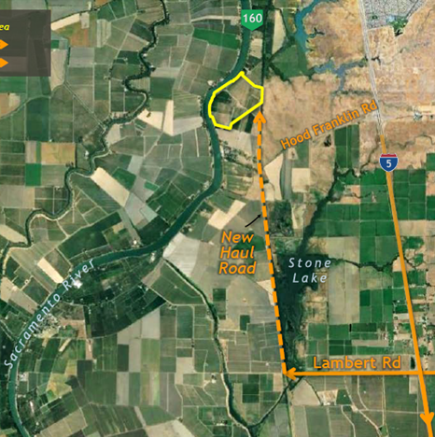
Tunnel Impacts…
14 years of construction
Air quality
Noise
Road, traffic, emergency access
Community & business disruption
Economic loss
Notes:
The proposed tunnel project will have devesting impacts to the communities in and around the Delta during the 14+ year construct
& longer impacts as part of the operations.
There are other alternatives, and we want to keep the water flowing through the delta,
an isolated conveyance is a threat, the tunnel takes freshwater out of the delta, bypassing the heart of the Delta and, so less water going through the delta impacts water quality and the intakes that serve the county (NBA) and intakes that supply water for ag in the county.
Tunnel provides no new water supply; there are other options that can provide additional supply
Through-Delta conveyance with levee reinforcement can increase reliability at lower cost than a tunnel (and with fewer impacts) and address levees concurrently
Reduced reliance on the Delta (through local storage, stormwater capture, reuse, desalination) will also improve the fishery
Continued concern that another engineered solution has project impacts on one region to benefit another

Slide 13
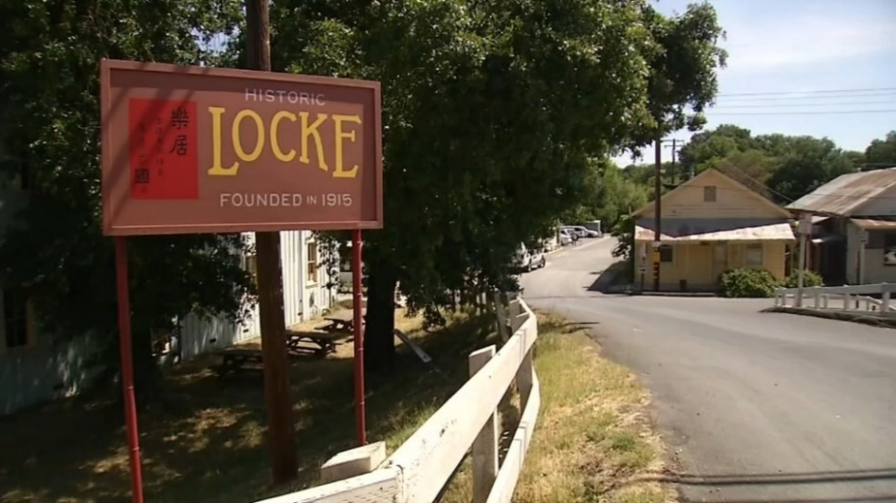
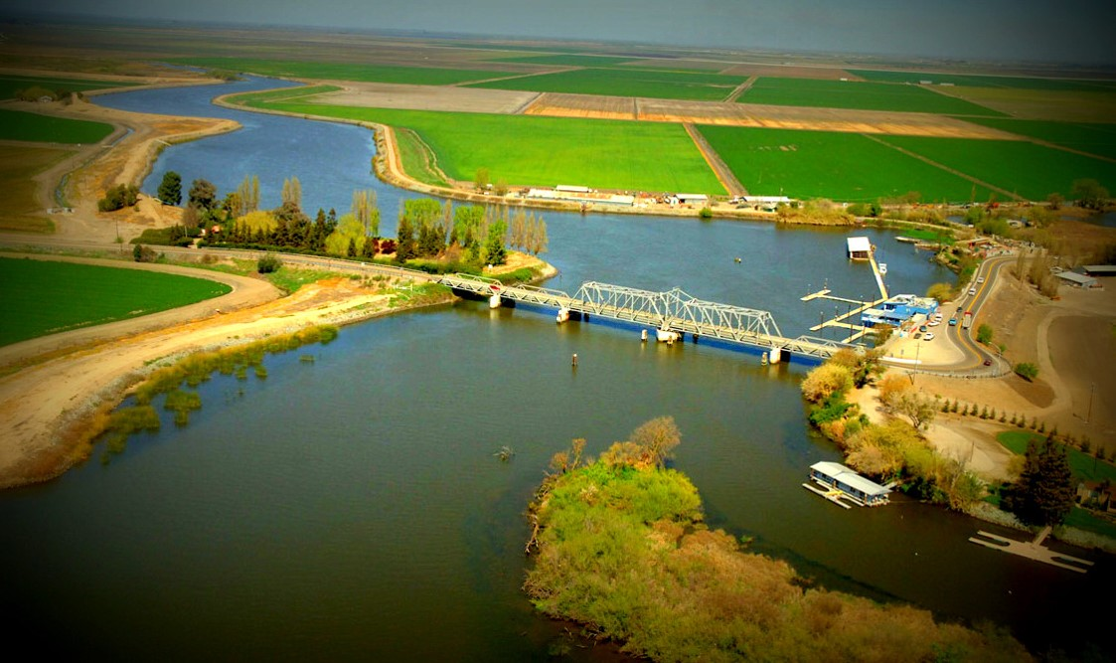
Tunnel Impacts…
14 years of construction
Historical communities
Recreational & waterway impacts
Agricultural land conversions for massive intakes & accesses
Notes:
The proposed tunnel project will have devesting impacts to the communities in and around the Delta during the 14+ year construct
& longer impacts as part of the operations.
There are other alternatives, and we want to keep the water flowing through the delta,
an isolated conveyance is a threat, the tunnel takes freshwater out of the delta, bypassing the heart of the Delta and, so less water going through the delta impacts water quality and the intakes that serve the county (NBA) and intakes that supply water for ag in the county.
Tunnel provides no new water supply; there are other options that can provide additional supply
Through-Delta conveyance with levee reinforcement can increase reliability at lower cost than a tunnel (and with fewer impacts) and address levees concurrently
Reduced reliance on the Delta (through local storage, stormwater capture, reuse, desalination) will also improve the fishery
Continued concern that another engineered solution has project impacts on one region to benefit another

Slide 14
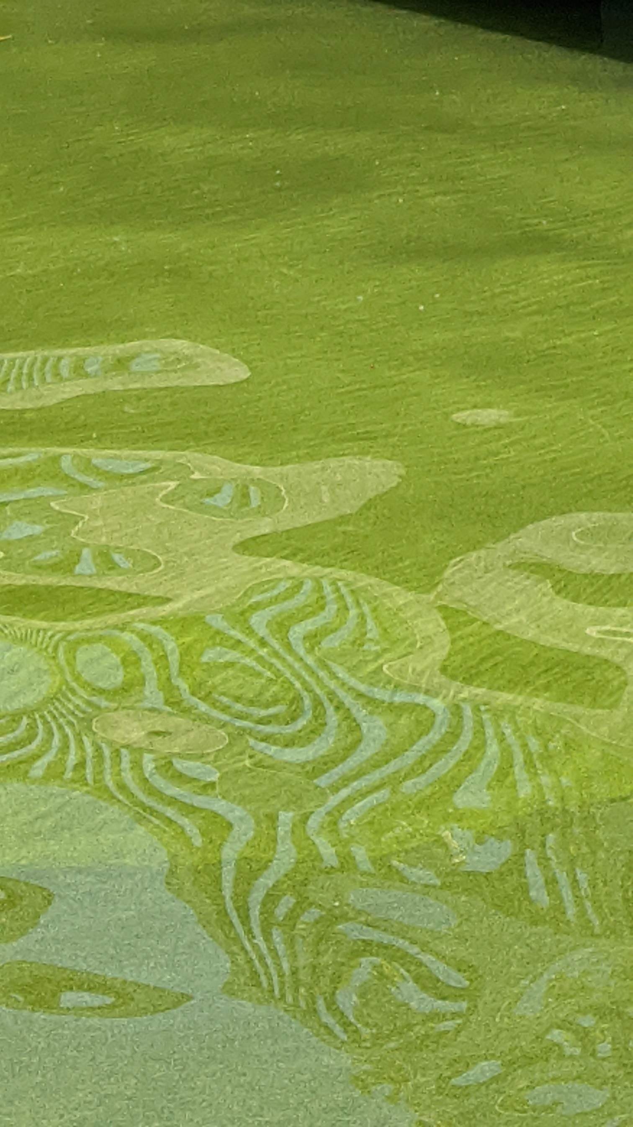
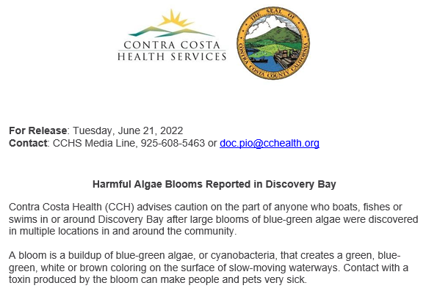
Tunnel Impacts…
Harmful
Algal
Blooms (HABs)
Notes:
The proposed tunnel project will have devesting impacts to the communities in and around the Delta during the 14+ year construct
& longer impacts as part of the operations.
There are other alternatives, and we want to keep the water flowing through the delta,
an isolated conveyance is a threat, the tunnel takes freshwater out of the delta, bypassing the heart of the Delta and, so less water going through the delta impacts water quality and the intakes that serve the county (NBA) and intakes that supply water for ag in the county.
Tunnel provides no new water supply; there are other options that can provide additional supply
Through-Delta conveyance with levee reinforcement can increase reliability at lower cost than a tunnel (and with fewer impacts) and address levees concurrently
Reduced reliance on the Delta (through local storage, stormwater capture, reuse, desalination) will also improve the fishery
Continued concern that another engineered solution has project impacts on one region to benefit another

Slide 15
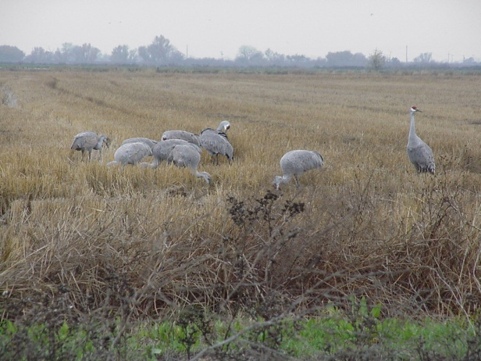
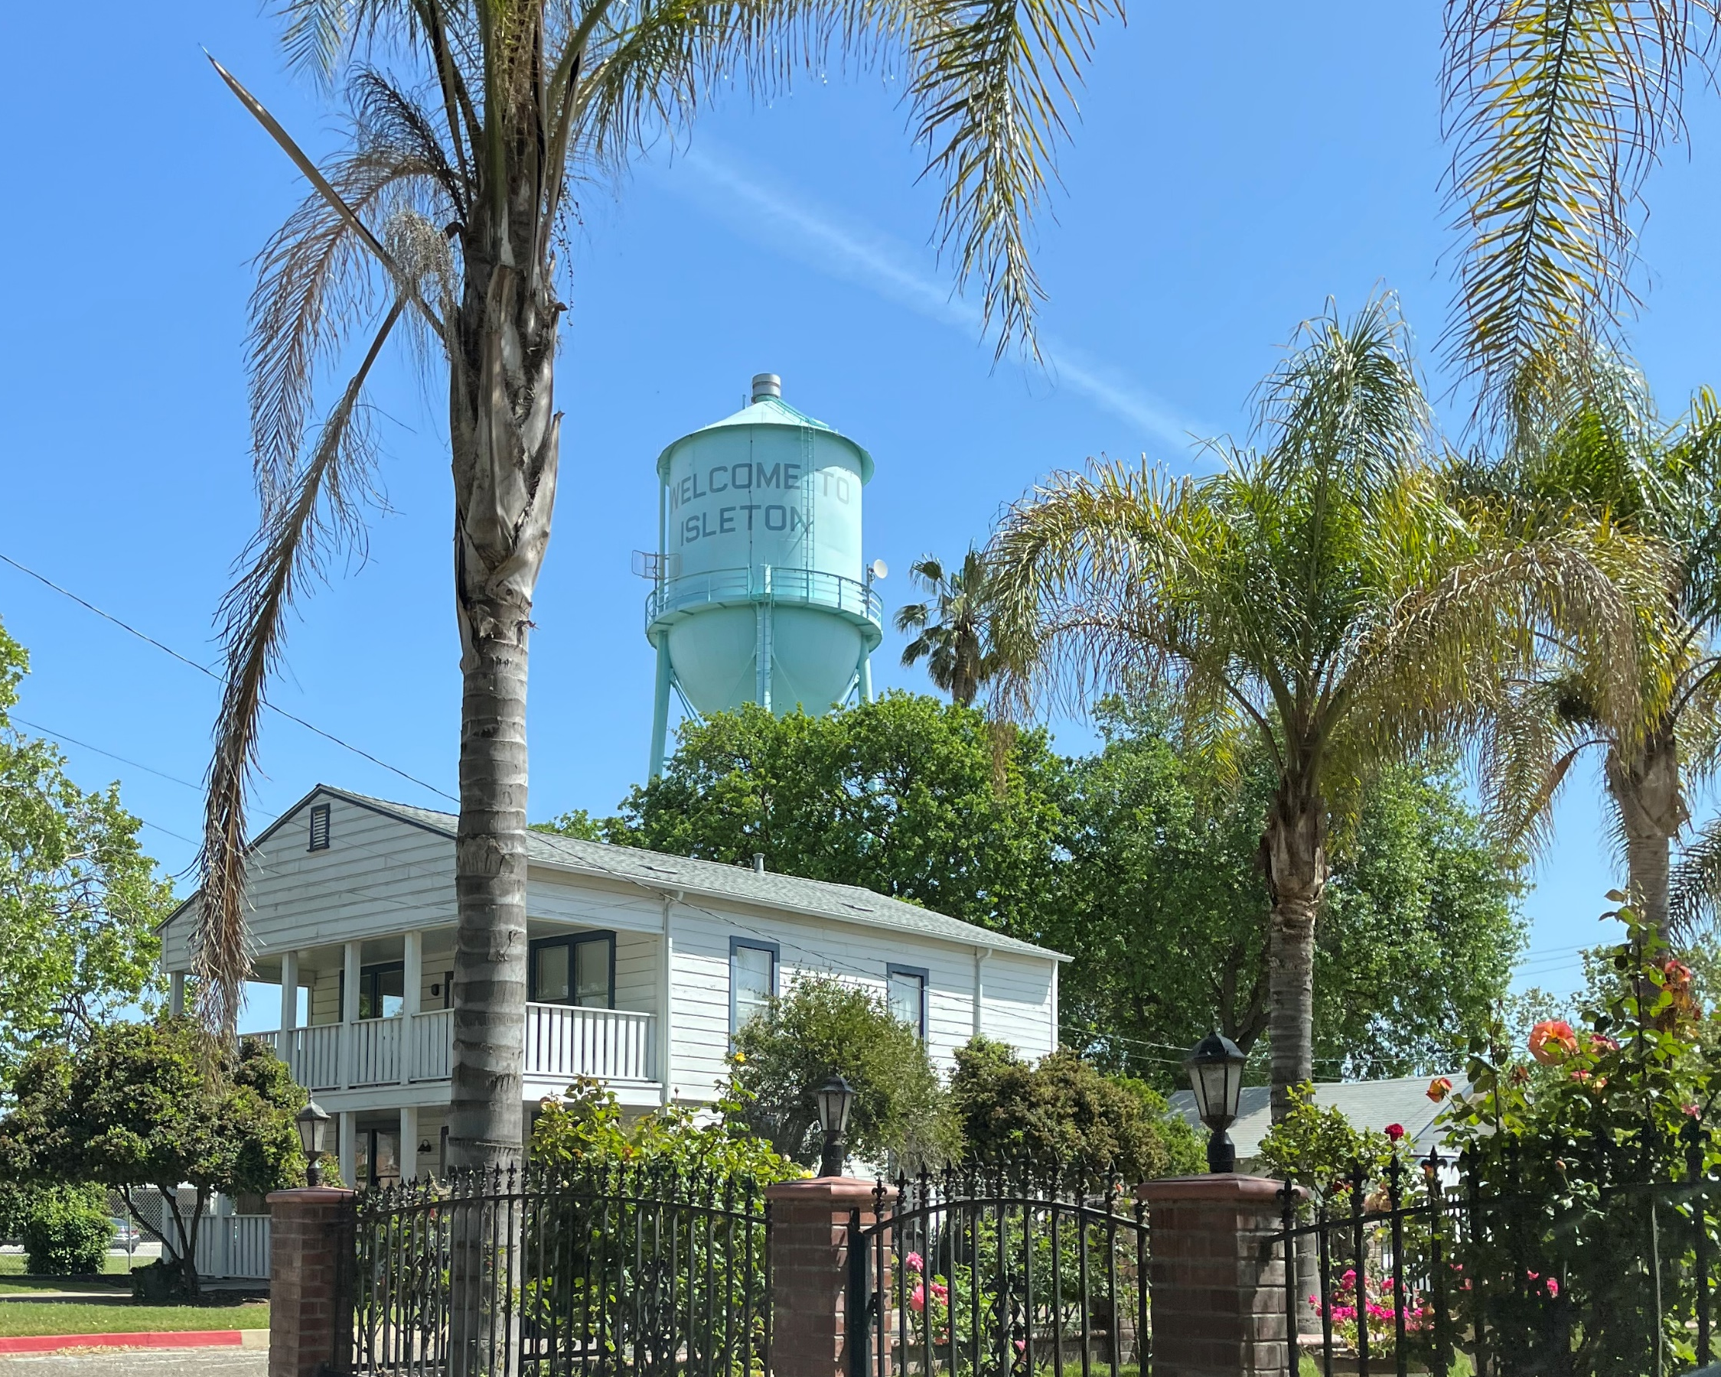
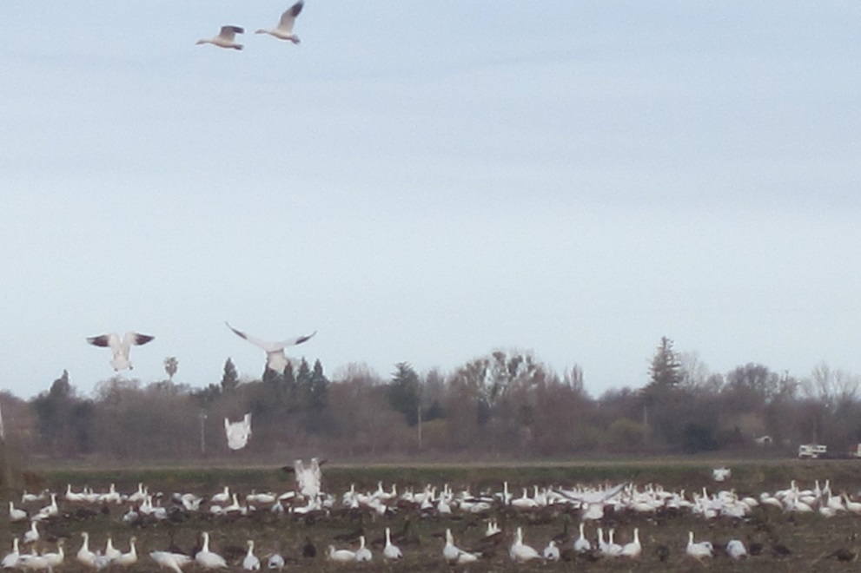
…More Tunnel Impacts
Permanent Operational Impacts:
  Municipal and Agriculture water quality
  Endangered species
  Recreation (fishing, swimming, boating)
  Social impacts to Delta communities
  Additional loss of Delta farmland (for habitat restoration to mitigate tunnel impacts)
Notes:
The proposed tunnel project will have devesting impacts to the communities in and around the Delta during the 14+ year construct
& longer impacts as part of the operations.
There are other alternatives, and we want to keep the water flowing through the delta,
an isolated conveyance is a threat, the tunnel takes freshwater out of the delta, bypassing the heart of the Delta and, so less water going through the delta impacts water quality and the intakes that serve the county (NBA) and intakes that supply water for ag in the county.
Tunnel provides no new water supply; there are other options that can provide additional supply
Through-Delta conveyance with levee reinforcement can increase reliability at lower cost than a tunnel (and with fewer impacts) and address levees concurrently
Reduced reliance on the Delta (through local storage, stormwater capture, reuse, desalination) will also improve the fishery
Continued concern that another engineered solution has project impacts on one region to benefit another

Slide 16
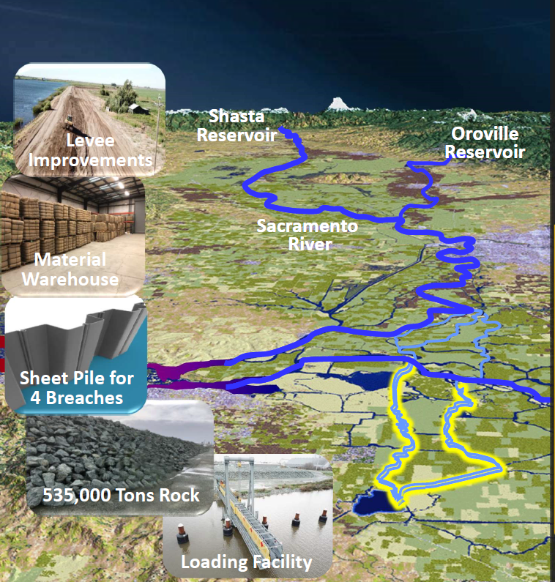
Better Alternative: Maintain Existing Freshwater Pathway
Risk Mitigation Options
Storage Releases
Operable Barriers
Freshwater Pathway
  Pre-Event
  Levee improvements
  Material stockpiles
  Integrated plans (County, State, Fed)
  Post Event
  Repair levees
  Close side channels
  Recover < 6 months
Notes:
[explain DWR resistance to evaluate – ability to address stated needs for Delta tunnel (seismic threat, water quality threat from SLR – brackish water desal like Antioch used and elsewhere around state?)
DWR has emphasized the need to avoid loss of delivery capability due to seismic impacts, but this ignores that (1) a levee repair can be accomplished quickly and (2) southern California water agencies have 6 months or more of supply in storage that they can rely on in the event of supply disruption.
It is not the case that if a levee were to fail, Southern California would immediately lose access to all its water supply, as some key state officials have misleadingly suggested.

Slide 17
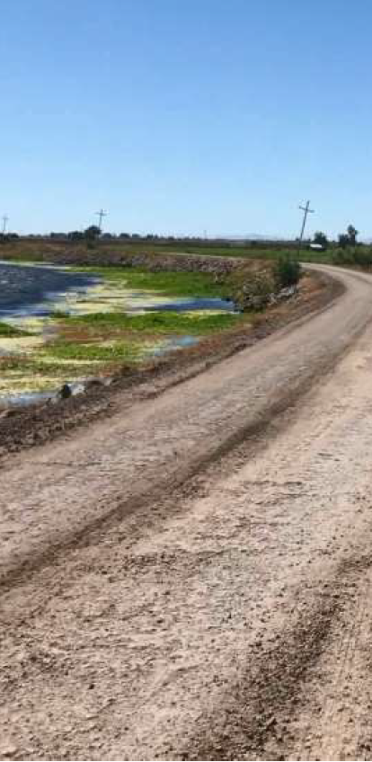
Progress Towards a
Freshwater Pathway
Summary
Accomplishments
Freshwater Pathway approach included in State Emergency Response/Preparedness Plan
Regional warehouses & stockpiles completed
Regional & local Delta seismic vulnerability analyses conducted
Potential outage reduced to < 6 months
Major portions of Middle River levee improved to meet mitigate flood and seismic events
Ongoing Activities
Evaluate new levee monitoring technologies
Continue developing on-island stockpiles
Further analysis of improving Old River levees

Slide 18
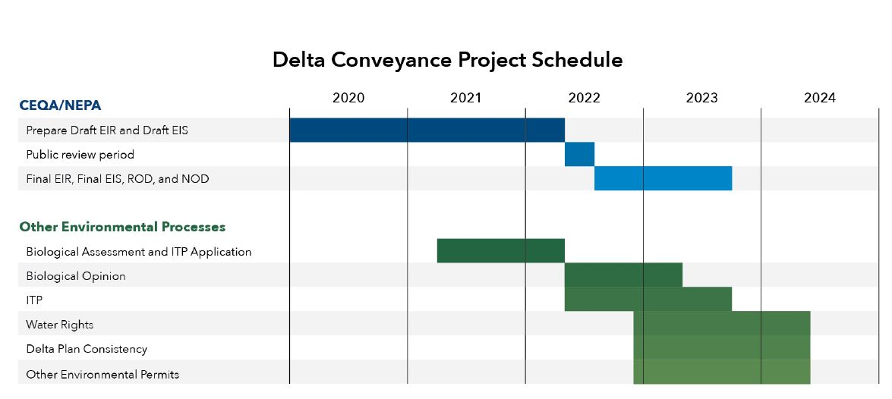
Delta Tunnel - Timeline
Opportunity for public input: CEQA Public Draft – Summer 2022
Notes:
The Draft EIR is expected to be released this summer
This latest iteration of the Delta conveyance project’s Draft Environmental document is set to be out to the public sometime mid year (possibly June/July). This is the time for the county & others to make comments on the impacts & all of the environmental documents that the state puts forward.
Once released, staff in coordination with DCC and others will be looking at the documents.
There’s opportunities to get involved and be heard as

Slide 19
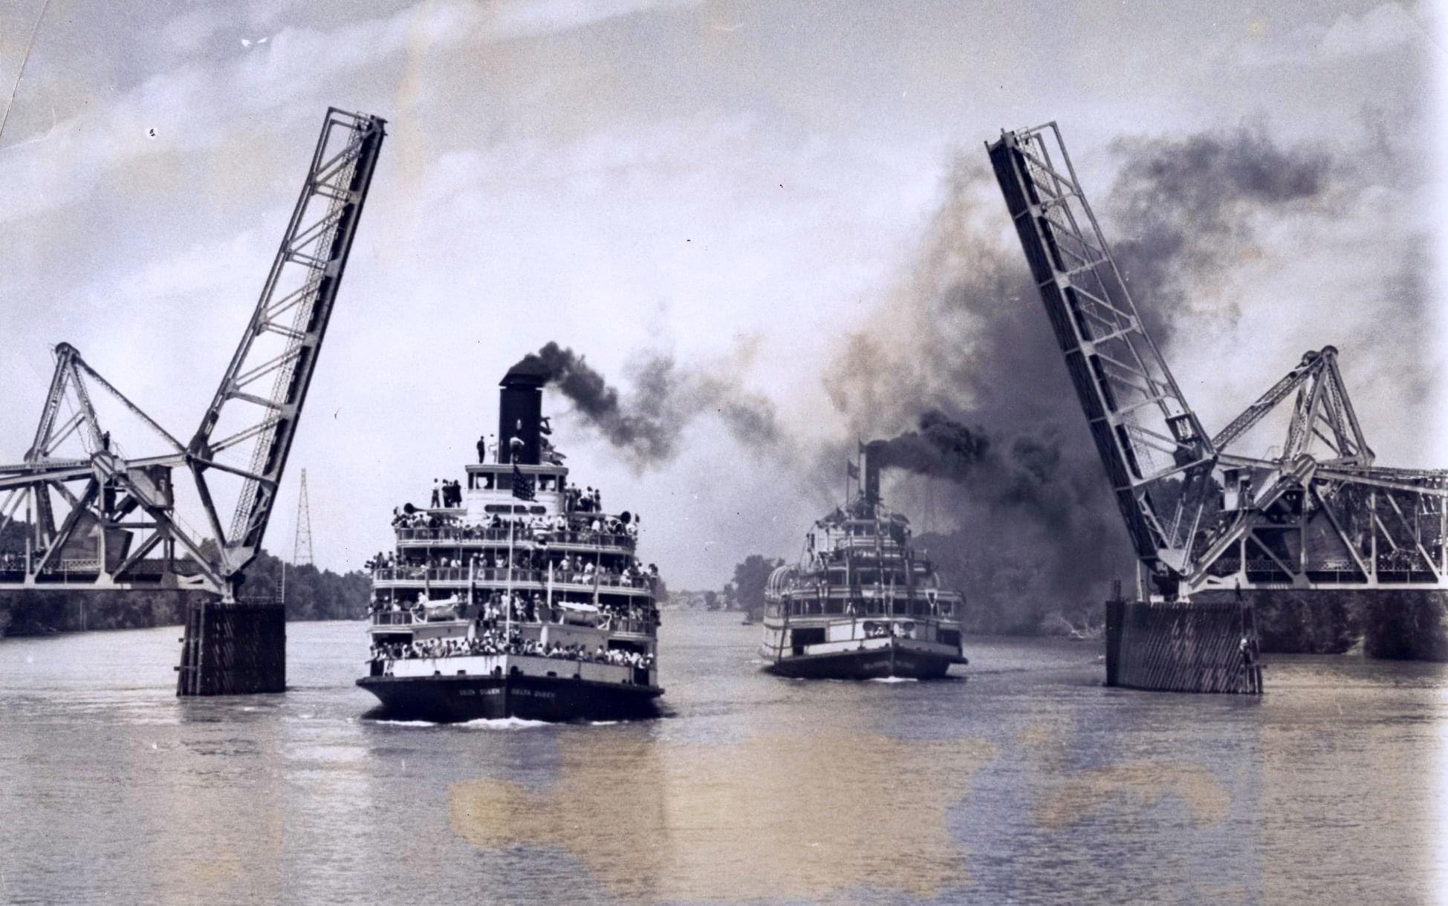
National Historic Preservation Act
Section 106
Protecting the Delta’s historic landscape
Avoiding and reducing impacts to historic properties
Delta King and Delta Queen on the Sacramento River --- 1930s
Notes:
Another opportunity to protect the Delta from damage by DWR’s tunnel is provided by the National Historic Preservation Act’s Section 106. This federal law requires the federal agency approving a project – in the case of DWR’s tunnel, that’s the Corps of Engineers – to consider ways to avoid or reduce damage to historic resources. The four Delta counties most directly affected by tunnel construction, should it be approved, have joined together with the Delta Protection Commission and some of the Indian tribes interested in the Delta to become what’s called “additional consulting parties” as the Corps considers ways to protect historic resources. This isn’t a process that can stop the tunnel, but if the tunnel is approved it will allow us to argue to for the best possible protection of the Delta landscape from a wide variety of impacts – not just damage to historic buildings and communities, but also scenic routes, historic farms, and other features, and to address a variety of tunnel construction’s damaging effects, including aesthetic impacts, noise, vibration, tunnel muck disposal, night lighting, traffic congestion, and other effects. The Delta Protection Commission is distributing a periodic newsletter to keep those who are interested informed about this effort, so if you are concerned about protecting the Delta’s historic properties you should get in touch with them at dpc@delta.ca.gov

Slide 20
Questions?
ryan.hernandez@dcd.cccounty.us
dranen@saccounty.gov
ktaber@somachlaw.com
osha@semlawyers.com

Slide 21
References
Delta Counties Coalition
https://delta.saccounty.gov/content/Pages/delta-counties-coalition.aspx
Department of Water Resources
https://water.ca.gov/deltaconveyance
Delta Conveyance Design & Construction Authority
https://water.ca.gov/deltaconveyance
Restore the Delta
https://restorethedelta.org/
Save the California Delta Alliance (STCDA)
https://nodeltagates.com/
Bay Delta Live Website
https://www.baydeltalive.com/
California Data Exchange Center
https://cdec.water.ca.gov/
Water Education Foundation
https://www.watereducation.org/aquapedia/sacramento-san-joaquin-delta

